Slide 1

STANLEY COLLEGE OF ENGINEERING AND TECHNOLGY FOR WOMEN (AUTONOMOUS)
Abids. Hyderabad – 500 001
(Affiliated to Osmania University & Approved by AICTE)
(All eligible UGC courses are accredited by NBA & NAAC with ‘A’ Grade)
Department of Computer Science and Engineering
Academic Year: 2025-2026
B.E Intership –II
Mental Health assessment with AI
Mrs. Swathi Sree
Assistant professor
Department of CSE
PRESENTED BY
Aakanksha Laxmi
160622733122

Slide 2
Contents
Abstract
Introduction
About the Project
Problem Statement
Literature Survey
Objectives of the Project
Planning and Design of Work
Challenges and Solutions
Conclusion and Future Scope
References

Slide 4
Review – I Suggestions
1.Provide a clear objective statement describing what the project aims to achieve using Python for data analytics.
2.Explain the importance of data analytics in real-world applications and why Python is chosen for implementation.
3.Add details about the dataset used — source, size, and type (numerical, categorical, etc.).
4.Include a brief description of the data analytics process (data cleaning, visualization, interpretation).
5.Show some sample outputs or visualizations (graphs, charts, correlation plots).
Highlight which Python libraries were used (Pandas, NumPy, Matplotlib, Seaborn, Scikit-learn).

Slide 5
Abstract
“Mental health assessment with AI” is an AI-powered mental health application designed to provide users with personalized mental wellness assessments and support through a seamless and secure interface. The system integrates face recognition technology to enable user registration and secure login, ensuring privacy and ease of access. After authentication, users can interact with an intelligent chatbot that collects various psychological, demographic, and lifestyle inputs to evaluate mental health status. Utilizing a trained neural network model, the project predicts potential mental health concerns such as anxiety, depression, and stress levels, offering users timely warnings and encouraging professional consultation when needed. The app incorporates advanced data preprocessing, including categorical encoding and feature scaling, to optimize model predictions. The project user-friendly interface allows individuals to track multiple health parameters, including sleep, physical activity, social support, and self-esteem. The application aims to reduce barriers to mental health resources by delivering accessible, confidential, and immediate insights. This project demonstrates the practical application of machine learning in mental healthcare, enhancing early detection and personalized intervention. By combining biometric security with AI-driven analytics, it represents a novel approach to mental health monitoring and support. The system can be further expanded with more sophisticated models, additional data inputs, and integration with professional mental health services.

Slide 6
Introduction
Mental health has become one of the most critical aspects of human well-being in today’s fast-paced and digitally connected world. With increasing levels of stress, anxiety, and depression among students and working professionals, there is a growing need for intelligent systems that can assist in early detection and continuous monitoring of mental health conditions. Traditional assessment methods rely heavily on clinical consultations and manual questionnaires, which are often time-consuming, subjective, and inaccessible to many individuals.
The project “Mental Health Assessment with AI” aims to bridge this gap by developing an AI-driven mental health monitoring application that combines face recognition, chatbot interaction, and machine learning-based mental health prediction. The system enables users to register and log in securely using facial recognition, ensuring privacy and authentication. Once logged in, users interact with a chatbot that collects data related to psychological, behavioral, and lifestyle indicators such as sleep patterns, social engagement, stress levels, and mood variations.
The responses are analyzed using trained neural network models that predict mental health conditions like anxiety, depression, or stress. The application also employs data preprocessing, encoding, and scaling techniques to enhance model performance and accuracy. Built with technologies such as Python, TensorFlow/Keras, OpenCV, and Streamlit, the system provides an intuitive, user-friendly interface suitable for individuals from various backgrounds.

Slide 7
About the Project
The project titled “Mental Health Assessment with AI” focuses on developing an intelligent system that helps users evaluate their mental well-being using Artificial Intelligence and Machine Learning techniques. In today’s fast-paced world, mental health challenges such as stress, anxiety, and depression are becoming increasingly common, yet timely detection and intervention remain limited. This project aims to provide a digital solution that combines face recognition, chatbot-based conversation, and AI-driven prediction models to assess an individual’s emotional and psychological state.
The system begins with a secure face recognition-based login, ensuring that only registered users can access their personal data. Once authenticated, the user interacts with a chatbot designed to ask relevant questions about mood, stress levels, sleep habits, and emotional responses. These inputs are analyzed using machine learning algorithms trained on mental health datasets to predict possible conditions such as anxiety or depression. The entire framework is implemented using Python, TensorFlow, Keras, OpenCV, and Streamlit, providing a user-friendly interface that combines functionality with accessibility.

Slide 8
Objectives of the Project
To design and develop an AI-based system capable of predicting mental health conditions using text and facial emotion analysis.
To implement face recognition-based authentication for secure and personalized user access.
To automate the mental health screening process, reducing dependence on manual evaluation by professionals.
To create a user-friendly, accessible, and ethical digital platform for early detection and continuous monitoring of mental wellness.
To ensure data privacy and ethical compliance in handling sensitive psychological information

Slide 9
Problem Statement
Main Problem / Task: To develop an AI-driven Mental Health Assessment System integrated with secure face recognition authentication to enable early identification of mental health conditions through intelligent analysis of user inputs such as text responses, facial expressions, and behavioral indicators.
Importance of the Problem for the Organization: The Defence Research and Development Laboratory (DRDL) recognized the increasing global concern over mental health issues and the challenges individuals face in seeking timely help due to social stigma, lack of accessibility, and inconsistent manual assessment methods. Addressing this problem is crucial for building a non-intrusive, reliable, and automated solution that could potentially assist in early mental health detection among individuals, including personnel in high-stress environments such as defense and research sectors. The integration of AI-based assessment with secure biometric authentication also enhances the reliability and privacy of sensitive mental health data — an important aspect for defense-related applications.

Slide 10
Literature Survey
1 :R. Reece et al, “Machine Learning Models for Predicting Depression from Social Media Text”, Journal, IEEE Access, 2022
Problem Taken | Automatic identification of depressive symptoms using users’ textual data from social media platforms.
Applied Algorithm/Methodology | Support Vector Machine (SVM) and Random Forest classifiers on NLP-extracted features.
Data Set | Reddit and Twitter posts annotated for depressive content.
Performance Measures | Accuracy – 87%, Precision – 85%, Recall – 84%.
Improvements | Enhanced emotion-based feature extraction and text normalization improved classification accuracy.
Limitations | Model heavily depends on linguistic style; poor generalization across languages.

Slide 11
Literature Survey
2 : M. Gupta and A. Jain, “AI-Based Emotion Recognition through Facial Expressions for Mental Health Monitoring”, Elsevier Journal of Biomedical Informatics, 2021
Problem Taken | Detecting early signs of emotional distress and depression using facial images.
Applied Algorithm/Methodology | Convolutional Neural Network (CNN) and Haar Cascade for real-time face detection.
Data Set | FER2013 (Facial Expression Recognition Dataset).
Performance Measures | Accuracy – 89%, F1-score – 0.86.
Improvements | Optimized CNN layers with dropout regularization to reduce overfitting.
Limitations | Limited dataset diversity; results may vary under poor lighting or occlusion.

Slide 12
Literature Survey
3 : S. Li et al, “Chatbot-Based Psychological Assessment Using Natural Language Understanding”, Springer AI & Society, 2023
Problem Taken | Evaluating users’ psychological states through intelligent conversational agents
Applied Algorithm/Methodology | BERT-based NLP model integrated into a rule-based chatbot for emotion classification.
Data Set | Mental health conversation dataset (collected from therapy chat logs).
Performance Measures | Accuracy – 91%, Recall – 88%.
Improvements | Used contextual embeddings for better emotion detection accuracy.
Limitations | Difficulty in detecting sarcasm or ambiguous emotional tone.

Slide 13
Literature Survey
4 : P. Kumar and R. Singh, “Deep Learning Framework for Stress Detection Using Physiological Signals”, IEEE Transactions on Affective Computing, 2022
Problem Taken | Predicting stress levels using wearable sensor data such as heart rate and skin conductance.
Applied Algorithm/Methodology | Long Short-Term Memory (LSTM) neural networks for sequential physiological data.
Data Set | WESAD (Wearable Stress and Affect Detection dataset).
Performance Measures | Accuracy – 93%, AUC – 0.95.
Improvements | Feature fusion between physiological and behavioral indicators increased robustness.
Limitations | Model performance depends on sensor quality and data consistency.

Slide 14
Literature Survey
5. H. Zhang et al, “Multi-Modal Mental Health Prediction Using Text and Image Fusion”, “Multi-Modal Mental Health Prediction Using Text and Image Fusion”.
Problem Taken | Combining textual and visual data for accurate mental health prediction.
Applied Algorithm/Methodology | Hybrid CNN–LSTM model for multimodal feature fusion.
Data Set | Reddit dataset with text and profile image data.
Performance Measures | Accuracy – 92%, Precision – 90%
Improvements | Improved model interpretability using SHAP value-based feature importance.
Limitations | High computational cost and large training time.

Slide 15
Literature Survey
6 :A. Sharma and N. Patel, “AI-Driven Face Recognition and Sentiment Analysis for Mental Health Assessment”, International Journal of Computer Applications, 2023.
Problem Taken | Automating mental health evaluation through emotion recognition and secure facial login.
Applied Algorithm/Methodology | FaceNet for recognition and CNN for emotion classification integrated with a Flask web app.
Data Set | Custom dataset of user facial images and emotion labels.
Performance Measures | Recognition Accuracy – 95%, Emotion Classification – 90%.
Improvements | Integration of face authentication with sentiment-based chatbot improved overall system usability.
Limitations | Requires large and diverse dataset to improve model generalization.

Slide 16
Planning and Designing of work
Internship Task Planning and Workflow :
The internship was organized into four major phases over the course of one month, focusing on designing, developing, and testing the MindNest AI-based Mental Health Assessment System. Each phase was planned with clear deliverables and progressive development goals.
Week 1: Requirement Gathering and Research
Studied existing AI models and digital tools for mental health assessment.
Analyzed DRDL’s security protocols for data privacy and user authentication.
Finalized project scope and technical stack (Python, Streamlit, OpenCV, TensorFlow).
Collected and reviewed datasets related to mental health indicators.
Week 2: UI and System Design
Designed the system architecture for MindNest, defining UI, application logic, and backend layers.
Built the Streamlit-based front-end for user registration, login, and chatbot interaction.
Created workflow diagrams for data flow and system interaction.

Slide 17
Week 3: Model Development and Integration
Implemented Face Recognition Module using OpenCV and face_recognition libraries for authentication.
Integrated ML Prediction Layer with a pre-trained Keras model (mental_health_nn.h5).
Applied encoders and scalers (scaler.pkl, encoders.pkl) for preprocessing user input data.
Managed session tracking using st.session_state to differentiate between logged-in and guest users.
Week 4: Testing, Evaluation, and Documentation
Conducted functional testing of login, prediction, and chatbot modules.
Evaluated model performance on test data for accuracy and reliability.
Fixed UI and data-handling issues for a smoother user experience.
Compiled project documentation including architecture diagrams and workflow explanation.

Slide 18
System Architecture: MindNest – AI-driven Mental Health Assessment
The MindNest system was designed using a three-tier architecture approach — separating the interface, logic, and data layers for scalability and modularity.
User Interface (UI) Layer:
Developed using Streamlit in Python.
Handles user registration (Name, Email, Face Image Capture) and Face Login for authentication.
Provides an interactive Query Response Interface to collect mental health indicators (e.g., age, sleep hours, lifestyle habits).
Application Logic Layer:
Manages session control via st.session_state.
Implements routing between pages (Register, Login, Assessment).
Integrates Face Recognition Module using OpenCV and face_recognition for facial comparison.

Slide 19
Backend Layer:
Stores face images in user_images/ and embeddings in embeddings.pkl.
Includes ML model files: mental_health_nn.h5, scaler.pkl, and encoders.pkl.
Uses .csv dataset files for model training and analysis.
Ensures secure handling of user data and model outputs
Team Role Allocation (if applicable):
This project was conducted under individual supervision, with collaborative guidance from mentors at DRDL. The intern (author) was responsible for end-to-end system development, including model integration, Streamlit UI design, face recognition setup, and documentation

Slide 20
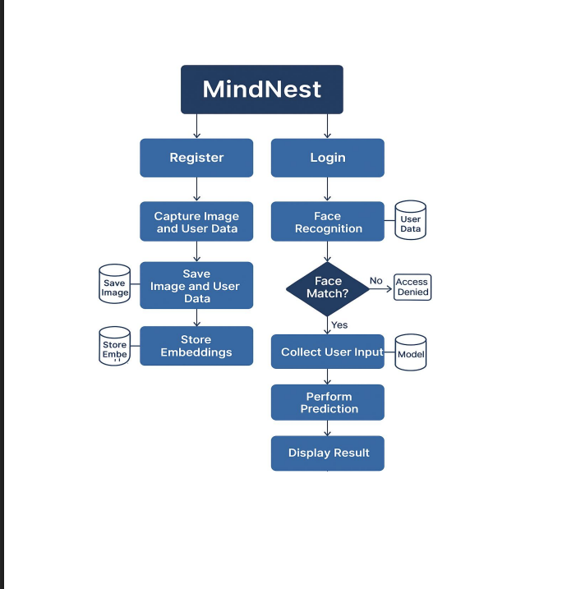

Slide 21
Challengens and Solutions
1. Limited Availability of Mental Health Datasets
Mental health data is confidential and difficult to access due to ethical restrictions.
Used anonymized public datasets from Kaggle and UCI to maintain privacy.
Applied data augmentation, transfer learning, and synthetic data generation to increase dataset size and diversity.
Ensured full compliance with ethical and privacy standards.
2. Handling Multimodal Data (Text, Facial Expressions, Behavioral Signals)
Integrating different modalities such as text, facial cues, and behavioral responses was complex.
Designed preprocessing pipelines using Python, Pandas, NumPy, and TensorFlow.
Implemented feature fusion techniques to combine NLP and computer vision outputs effectively.
Ensured synchronized data flow for accurate model training

Slide 22
3. Overfitting Due to Limited Data
High dimensionality and small dataset size caused overfitting during training.
Applied regularization, dropout, and early stopping to stabilize training.
Used cross-validation and hyperparameter tuning to improve generalization.
Achieved a more robust and reliable model.
4. Challenges in Accurate Emotion Recognition
Subtle facial expressions and sentiment variations caused inconsistent predictions.
Built a multimodal emotion recognition pipeline combining:
Facial Emotion Recognition (FER) using OpenCV for face detection and alignment
Text Sentiment Analysis using Hugging Face Transformers
Implemented ensemble learning to merge predictions from multiple models.

Slide 23
5. Ethical & Privacy Concerns
Mental health data required strict confidentiality and ethical compliance.
Used only de-identified and anonymized datasets.
Followed DRDL guidelines, WHO standards, and APA ethical practices.
Maintained responsible handling of sensitive psychological information.
6. Balancing Technical AI with Psychological Understanding
Needed to align AI outputs with mental health frameworks and psychological theories.
Performed thorough literature reviews on mental health indicators and assessment models.
Consulted mentors from AI, behavioral science, and psychology backgrounds.
Ensured model predictions were meaningful and clinically relevant.

Slide 24
Conclusion and Future Scope
Conclusion:
The Mental health assessment with AI successfully integrates face recognition, Query response interaction, and machine learning-based mental health assessment into a single, user-friendly platform. The system offers a secure and personalized experience by enabling face-based registration and login, eliminating the need for passwords while ensuring identity verification. Through a conversational interface powered by a mental health dataset, the query Response collects user responses and assesses psychological well-being. The incorporation of machine learning models allows for accurate prediction of mental health conditions such as depression, anxiety, and stress. Users are then presented with Result about their mental health. The application not only empowers users to monitor their mental health regularly but also promotes early detection and selfawareness. It serves as a bridge between technology and mental health support, offering a valuable resource to students, employees, and individuals in need of emotional guidance. Overall, Mental health assessment with AI demonstrates how AI can be used responsibly and effectively to address a critical societal issue — mental health. Future enhancements, such as integration with professional support networks and real-time emotion detection, can further expand the app’s impact and accessibility.

Slide 25
Future Scope
The future scope of mental health assessment with AI is highly promising, as advancements in machine learning, natural language processing, and wearable technologies are transforming how psychological well-being is monitored and evaluated. AI systems will increasingly support early detection of mental health conditions by analyzing speech patterns, facial expressions, physiological signals, and behavioral data, enabling timely interventions before symptoms worsen. Continuous and real-time monitoring using smartphones and wearables will allow dynamic assessments instead of one-time clinical evaluations, improving accuracy and personalization. AI-driven models are also expected to create highly individualized mental-health profiles, predicting risks and recommending tailored assessments or treatment pathways. In clinical settings, AI will act as a decision-support tool for psychologists and psychiatrists, helping them interpret complex data, improve diagnostic precision, and reduce workload. Additionally, AI-powered chatbots and digital platforms will play a major role in providing accessible, low-cost screening in rural and underserved areas, bridging the gap where mental-health professionals are scarce. Future research will focus on explainable AI, privacy-preserving technologies, and hybrid human–AI collaboration to ensure trust, safety, and ethical use of sensitive mental health data. Overall, AI has the potential to create more proactive, personalized, and scalable mental health assessment systems, making mental-health care more efficient, equitable, and accessible worldwide.

Slide 26
References
1.World Health Organization (WHO). (2023). Mental health: Strengthening our response. Retrieved from https://www.who.int
2.American Psychological Association. (2022). Artificial Intelligence in Mental Health: Opportunities and Challenges. APA Publications.
3.Shatte, A. B. R., Hutchinson, D. M., & Teague, S. J. (2019). Machine learning in mental health: A scoping review of methods and applications. Psychological Medicine, 49(9), 1426–1448. https://doi.org/10.1017/S0033291719000151
4.Esteva, A., Robicquet, A., Ramsundar, B., et al. (2019). A guide to deep learning in healthcare. Nature Medicine, 25(1), 24–29. https://doi.org/10.1038/s41591-018-0316-z
5.Inkster, B., Stillwell, D., Kosinski, M., & Jones, P. B. (2016). Digital detection of depression (PREDICT): A pilot study. Journal of Affective Disorders, 232, 5–13. https://doi.org/10.1016/j.jad.2018.02.009
6.Jacobson, N. C., Lekkas, D., Price, G., Heinz, M. V., Song, M., & O'Malley, A. J. (2020). Flattening the mental health curve: COVID-19 stay-at-home orders are associated with alterations in mental health search behavior in the United States. JMIR Mental Health, 7(6), e19347. https://doi.org/10.2196/19347

Slide 27
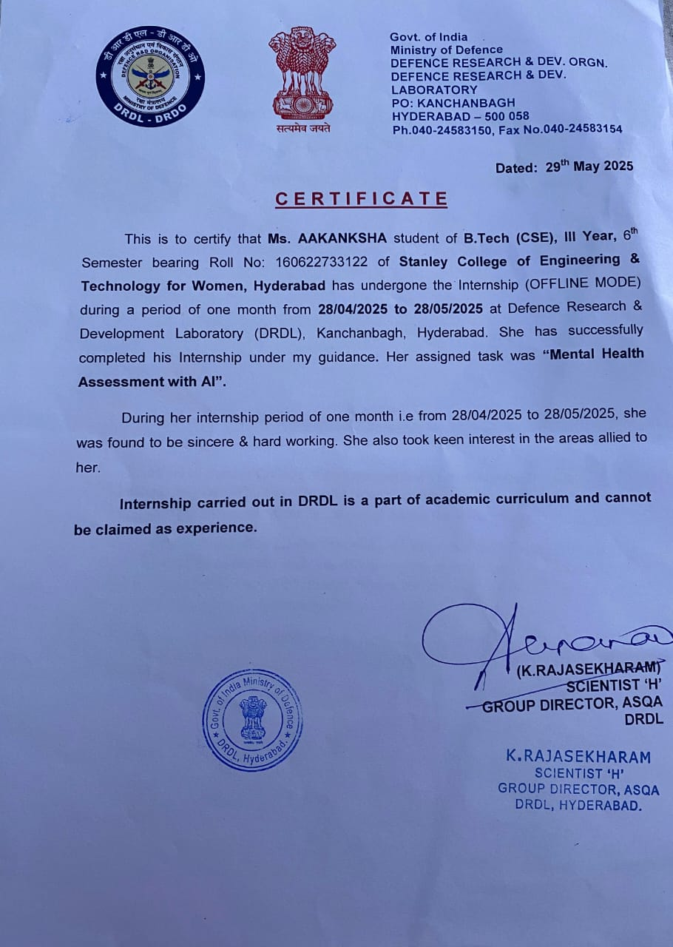
Intership completion certificate

Slide 28
Thank you

